Slide 1


Analyzing Globular Cluster Systems in PLCK G165.7+67.0
Tyler Hinrichs
Mentors: Rogier Windhorst & Patrick Kamieneski
Arizona State University

Slide 2
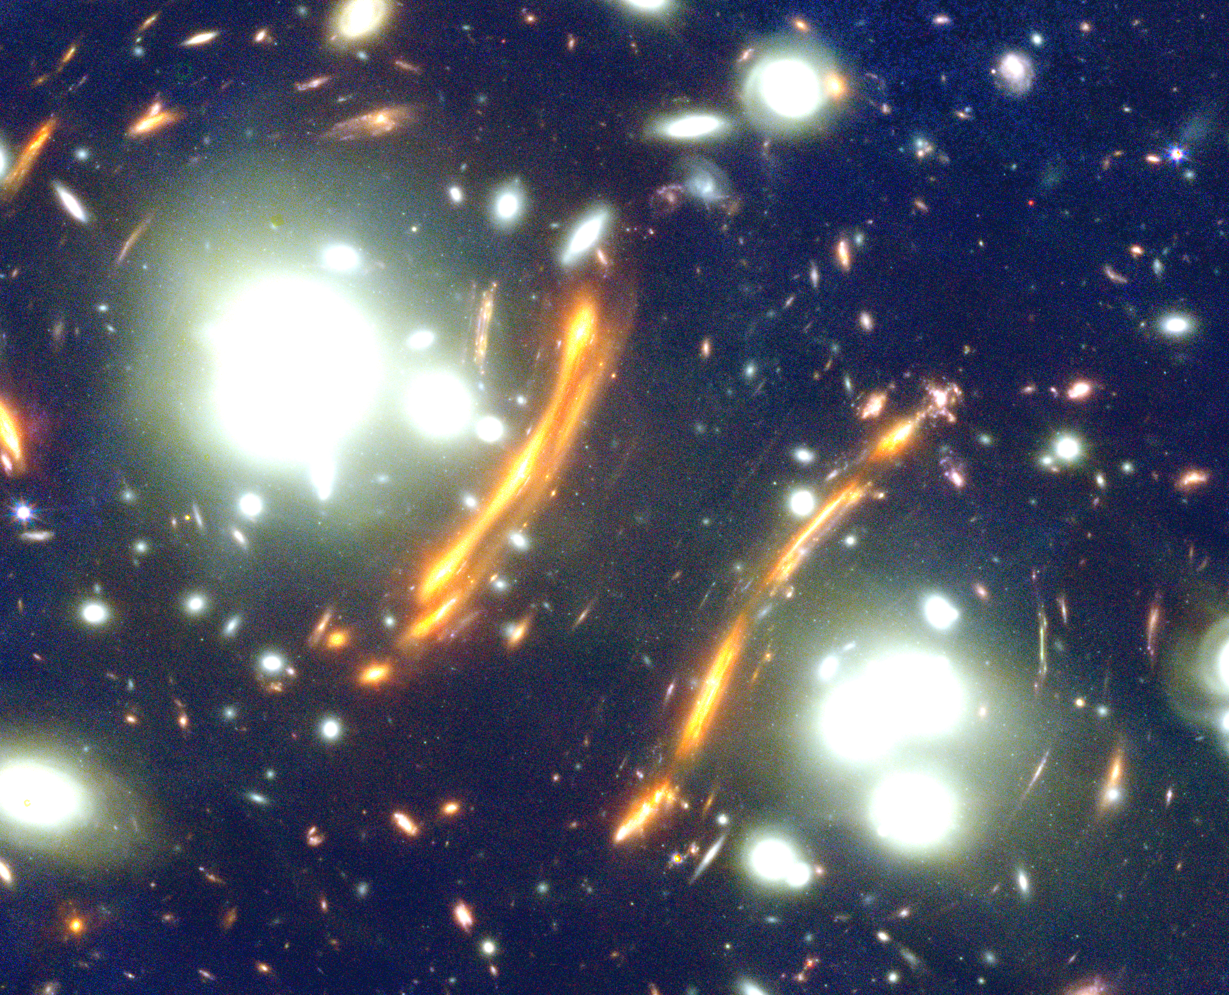
G165 Introduction
G165 is a galaxy cluster with a bimodal distribution that was observed by the James Webb Space Telescope in March/April 2023.
G165 is at a redshift of 0.35, meaning the light we see happened around 4 billion years ago, or 9 billion years after the Big Bang.
G165 has received much attention for its prominent “arcs”, but this work is focused on the point sources within the emitted light.

Slide 3
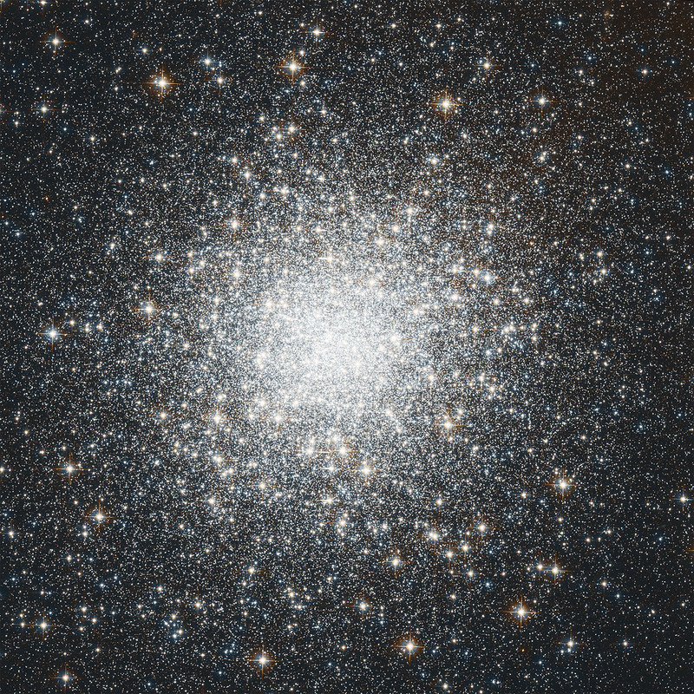
Introduction to Globular Clusters
Image credit: NASA, ESA, STScI, and A. Sarajedini (University of Florida)
Globular clusters (GCs) are clusters of millions of gravitationally bound stars.

Slide 4
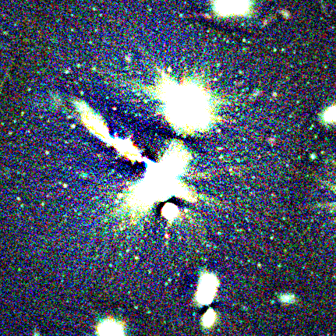
Introduction to Globular Clusters
Image credit: NASA, ESA, STScI, and A. Sarajedini (University of Florida)
Each point source around galaxy clusters (example on right) is a single globular cluster or compact galaxy.

Slide 5
Introduction to Globular Clusters
Image credit: NASA, ESA, STScI, and A. Sarajedini (University of Florida)
Project goals: Identify sample of only GC candidates. Use the GC candidates to look at the Globular Cluster Luminosity function and compare their spatial distribution to the galactic light and mass distribution of G165.

Slide 6
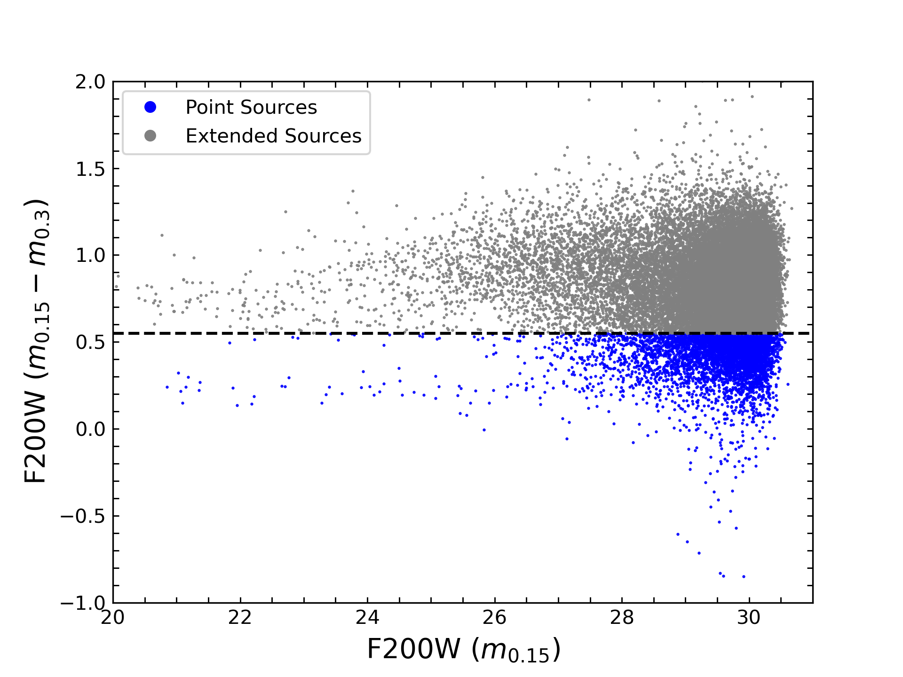
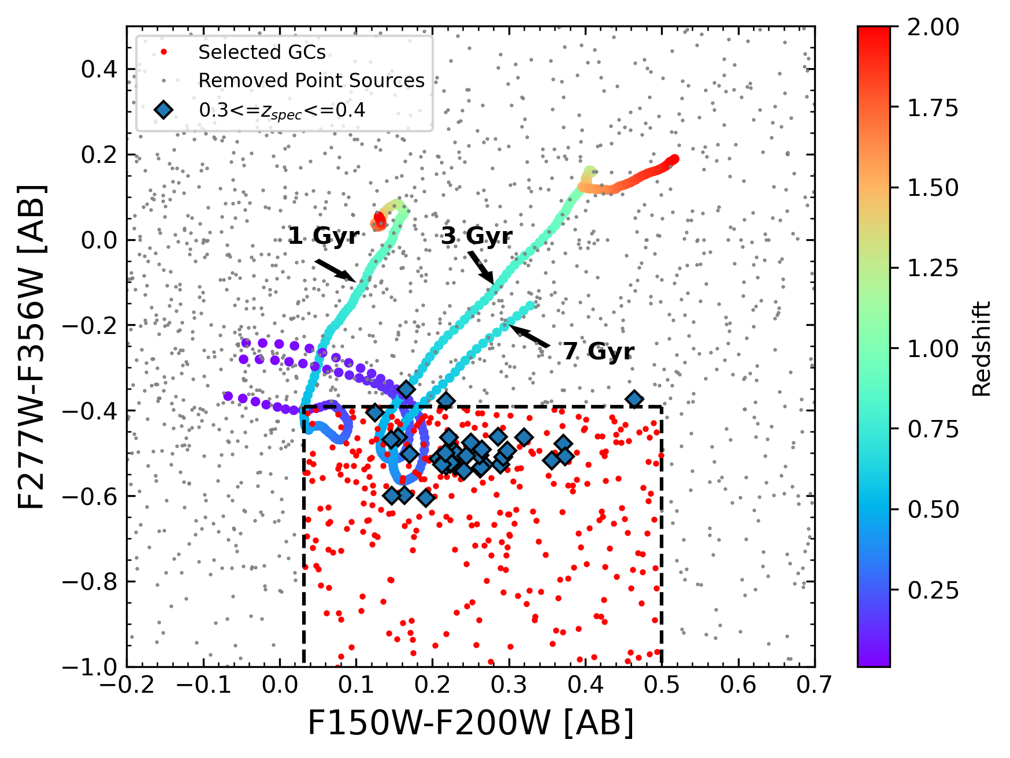
Methods: Selection Approach #1
This approach yielded 452 GC candidates (much lower than expected!).
Previous studies show that a galaxy cluster this size should have ~10,000 detected GC candidates.

Slide 7
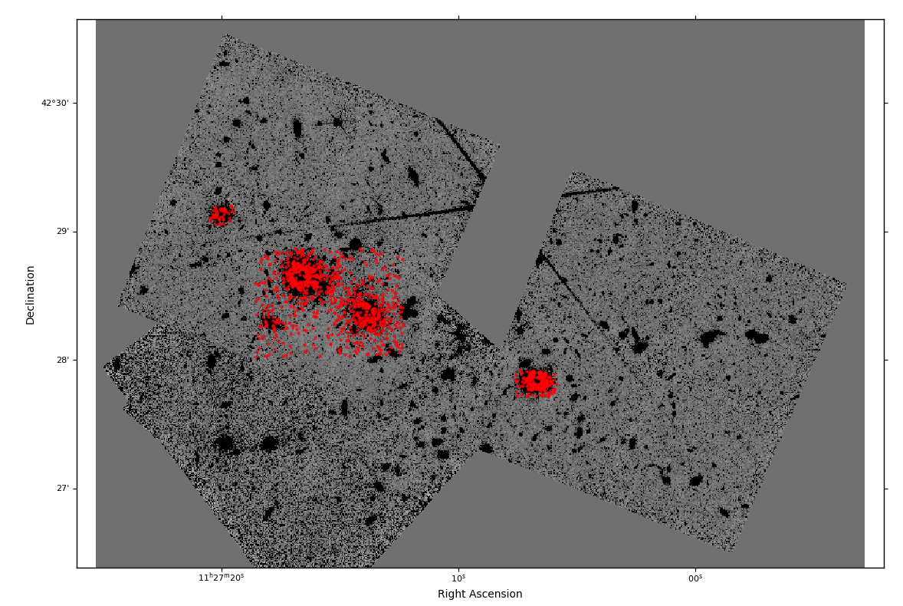
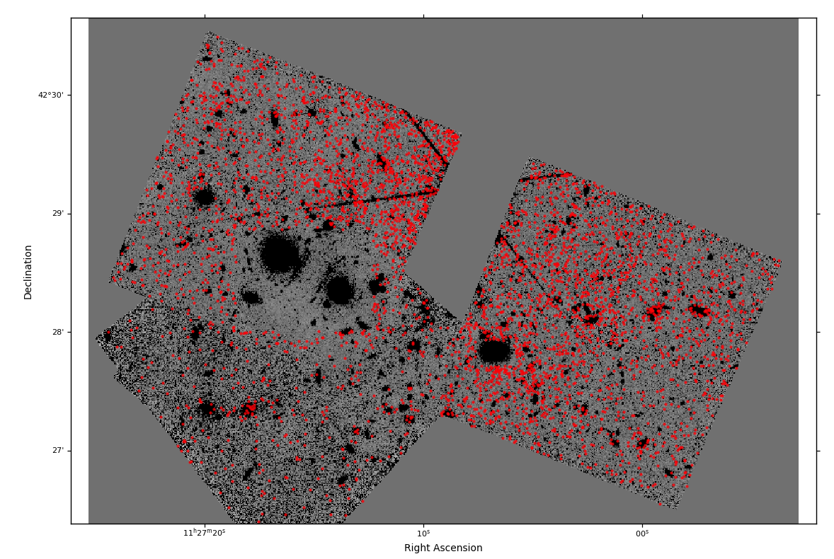

Methods: Selection Approach #2
Cluster
Background
$$N_{GC}=\left(\frac{N_{cluster}}{A_{cluster}}−\frac{N_{background}}{A_{background}}\right) × ( A_{cluster}+A_{background})$$
This alternative selection yielded ~12000 GC candidates, closely matching expectations.

Slide 8
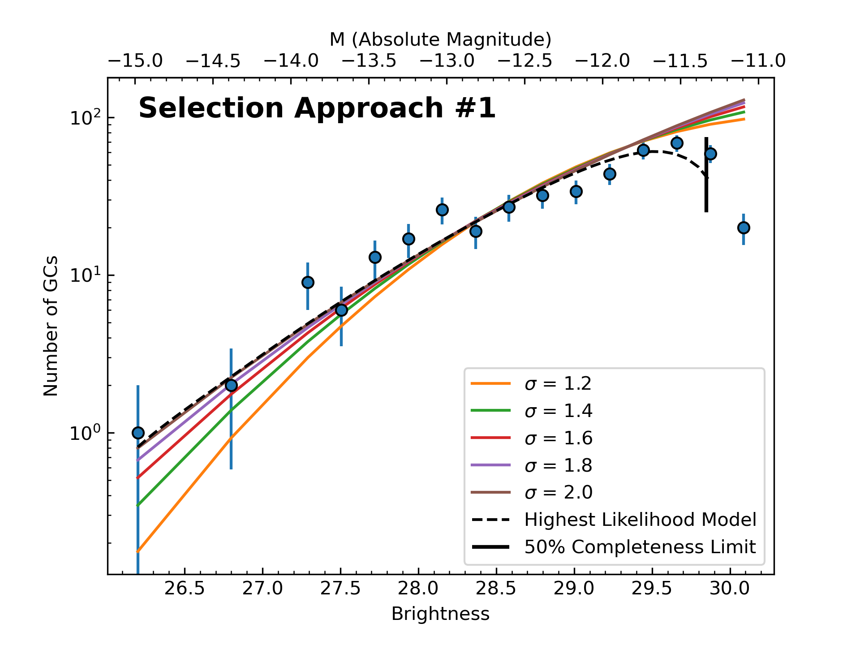
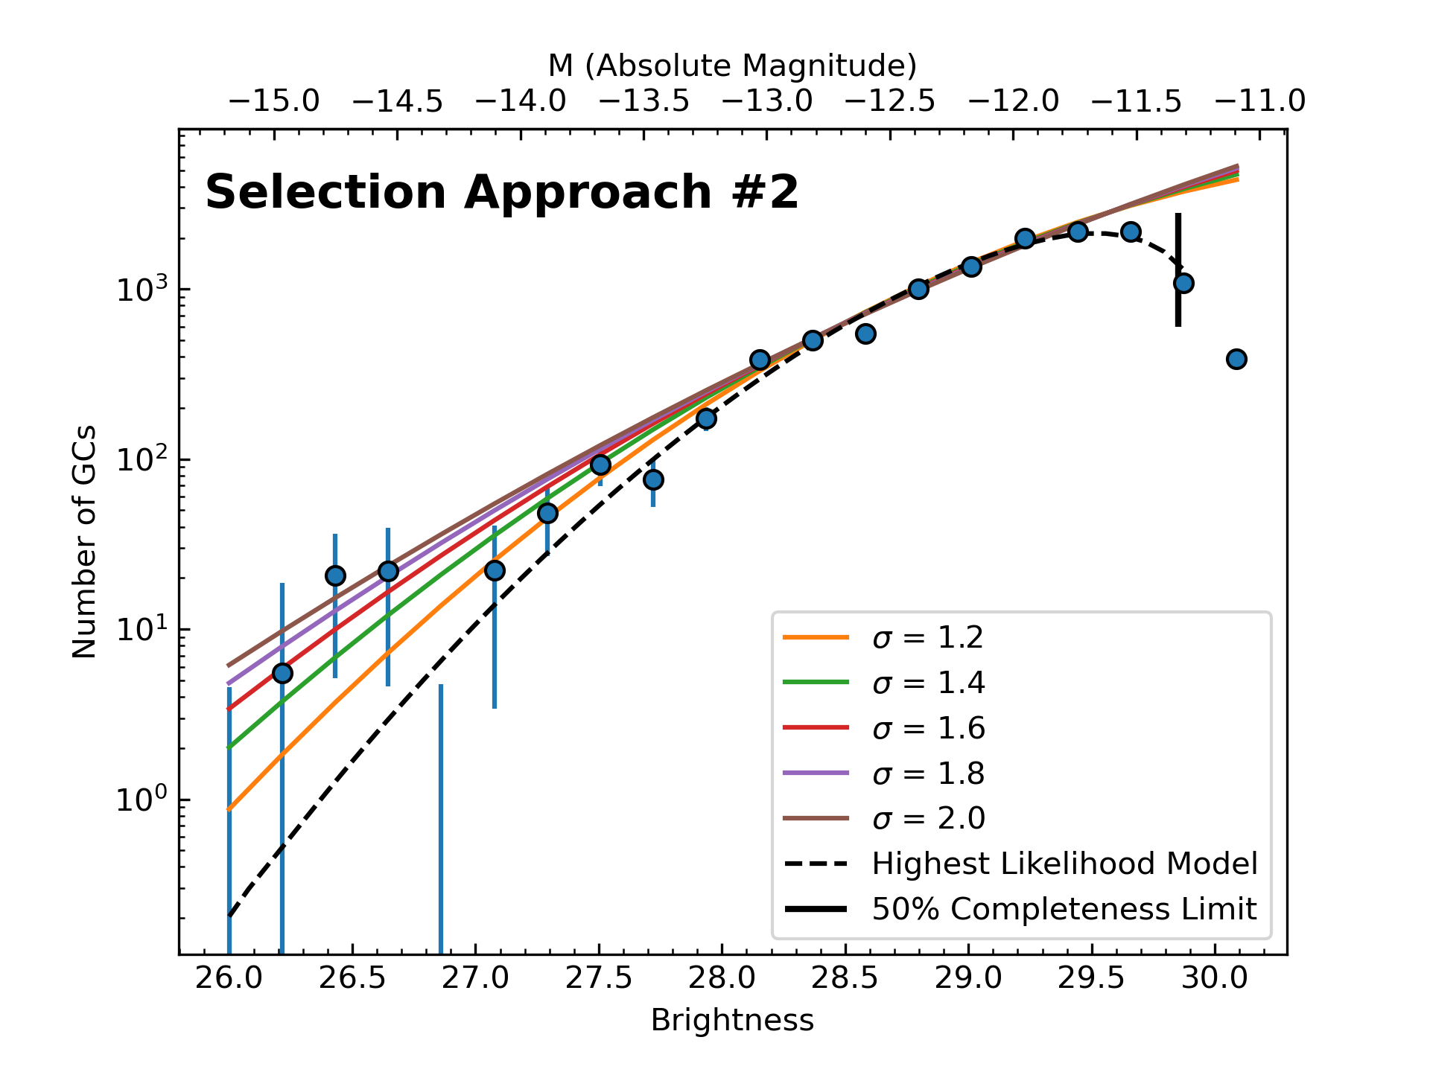
Globular Cluster Luminosity Function (GCLF)
The peak of the GCLF can be used to find the expansion rate of universe, since it has a universal shape.
For G165, the best-fit predicted peak is at M ~ -10.14 mag using both selection approaches.

Slide 9
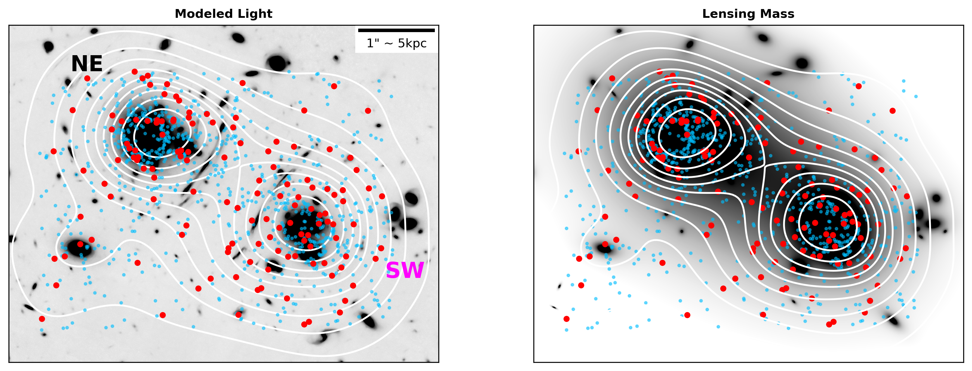
Comparison of GC Spatial Distribution & Light/Mass
The white contour lines computed from the color-selected GC candidates (red points), show there is high correlation between the GC spatial distribution and light/mass.
Light blue points show the point source sample, further indicating how restrictive our color selection (approach #1) is.

Slide 10
Conclusion & Future Work
Both selection methods of choosing GC candidates point towards a peak in the GCLF at M ~ -10.14.
We find high correlation between the spatial distribution of color-selected GC candidates (approach #1) and the light/mass distribution.
Future Work:
Future observations of G165 will allow us to select GCs more reliably and look deeper into the GCLF.
The comparison of GC spatial distribution to the light/mass distribution can be quantitatively shown and compared to other galaxy clusters.
Studies of GC systems in many other galaxy clusters observed by JWST can be done.

Slide 11
Thank you!
Acknowledgements:
Thank you to ASU/NASA space grant, my primary mentors (Dr. Rogier Windhorst and Dr. Patrick Kamieneski), and many others for the support in this project.

